Slide 1
Plasmon Assisted Nanotrapping
E. P. Furlani, A. Baev and P. N. Prasad
The Institute for Lasers, Photonics and Biophotonics
University at Buffalo, SUNY

Slide 2
Overview
Introduction
Applications
Experimental Results
Modeling Nanotrapping Systems
Summary

Slide 3
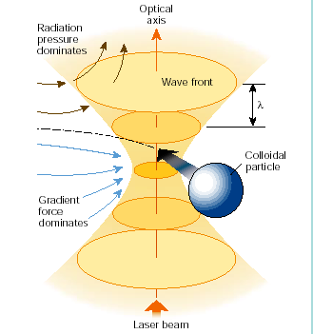
Optical Trapping – Laser Tweezers
Powerful tool for remote manipulation of microscopic biomaterial.
Strongly focused laser beam creates gradient optical force that traps particles.
Not ideal for nanoscale trapping (diffraction limitation, heating).
Not well suited for integration with Lab-on-Chip systems (opto- fluidics).
D. G. Grier Nature 424 2003

Slide 4
Plasmonic-based Optical Nano-trapping
Locally enhanced field near illuminated metallic nanostructures creates gradient optical force that traps nanoparticles.
E_{inc}(t)
Dielectric
Nanoparticle
Well suited for trapping sub-wavelength metallic or dielectric particles.
Potential for integration with Lab-on-Chip systems (opto-fluidics).
ε_{p}
+ -
+ -
+ -
+ -
Gold Nanocones

Slide 5
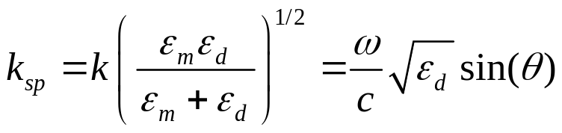
Surface Plasmon Resonance (SPR) and Localized SPR (LSPR) in Metallic Nanostructures
Plasmon: Quantized charge density wave in free electron gas.
E
Strong Local Field
ε_{d}
SPR: Surface plasmons confined to metal/dielectric interface.
- - -
+ + +
- - -
+ + +
- - -
ε_{m}
H
.
Wave vectors
θ
E(t)
+ + +
- - -
LSPR: Resonant scattering modes in sub-wavelength metallic nanoparticles
- - -
+ + +

Slide 6
Motivation for LSPR Nanotrapping
Higher Resolution: optical nano-manipulation of sub-wavelength particles (d << λ) (overcome diffraction limit).
Reduced Power: optical intensity an order of magnitude lower then conventional optical tweezers
Multiplexed Nano-trapping: multiplexed parallel manipulation of particles using arrays of metallic nanopaticles
Microsystem Integration: integrated optical particle manipulation/separation for BioMEMS, Lab-on-a-Chip systems.

Slide 7
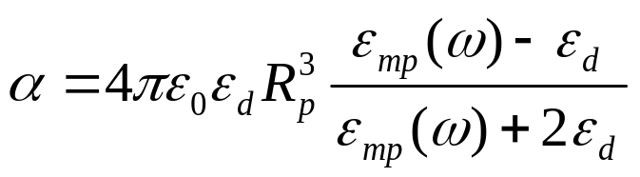
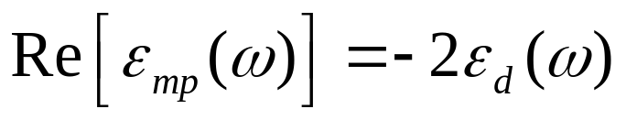
Local Field Enhancement
Metallic Nanoparticles
E(t)
ε_{d}
+ + +
- - -
P(t) = αE(t)
ε_{mp}
- - -
+ + +
Optical Absorption - Scattering
Local Field Enhancement
Absorption frequency/bandwidth depend on particle size, shape, composition and surrounding media etc.

Slide 8
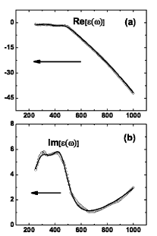
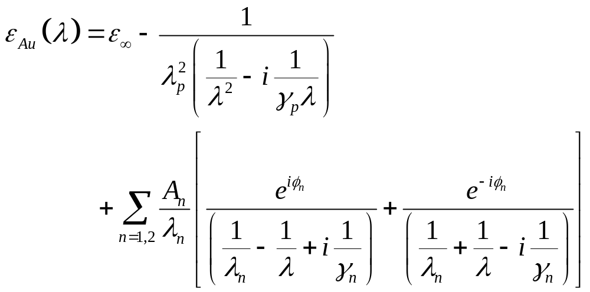
Analytical Dielectric Function for Au Nanostructures
Experimental and analytical dielectric values vs. λ
E_{inc}
+ -
+ -
+ -
+ -
Analytical Dielectric Function for Au used in Analysis*
*P. G. Etchegoin et al. J. Chem. Phys. 125, 164705 (2006)

Slide 9

Optical Trapping of
Sub-Wavelength Neutral Particles
Force on Dielectric Nanoparticle caused by Local Field Gradient produced by Illuminated Metallic Nanoparticles
Dielectric Nanoparticle
Metallic Nanostructures

Slide 10
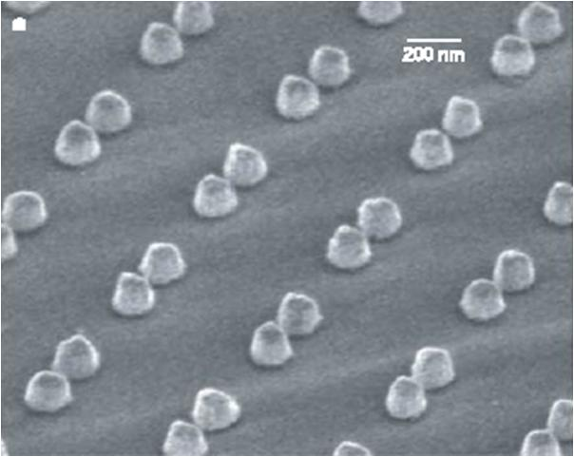
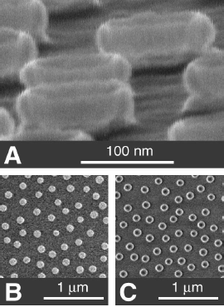
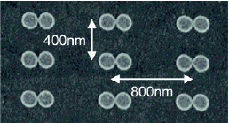
Fabricated Metallic Nanostructures
Nano-cone Array
Nano-Ring Array
Nano-Pillar Array
T. Atay et al., Nano Letters 4 2004
J. Aizpurua et al., PRL 90 2003

Slide 11
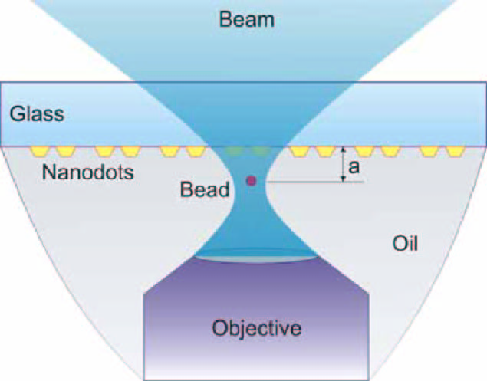
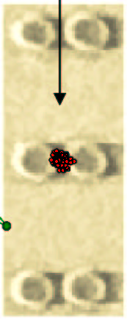
Experimental Results
Optical trapping of nanoparticles using tapered metallic nanopillars
90 nm
120 nm
1 μm
Collaboration with A. N. Grigorenko et. al, Nanometric optical tweezers based on nanostructured substrates, U. Manchester UK

Slide 12
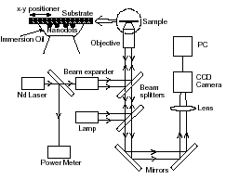
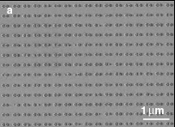
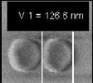

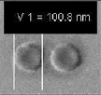



Optical Trapping of Microbubbles on Nanostructured Substrate
90 nm
120 nm
A.R. Sidorov et al. Optics Communications 278 (2007)

Slide 13
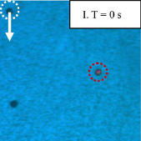
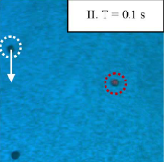
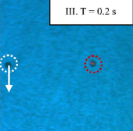
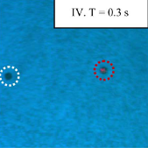
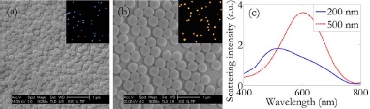
Enhanced Optical Trapping
Au Nanoparticle Array
Moving Dielectric Sphere
Trapped Dielectric Sphere
Size of Trapped Particle | D = 6.8 μm | D = 1 μm | D = 0.8 μm
Optical Trapping Intensity (μW/μm²) with Au NP Array | 0.71 | 3.4 | 3.8
Optical Trapping Intensity (μW/μm²) with Glass Slide | 7.1 | 6.0 | 7.6
Array of Au Nanostructures
X. Maio and L. Y. Lin, Opt. Letters. 32 2007, also unpublished work 2008

Slide 14
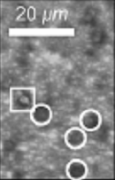
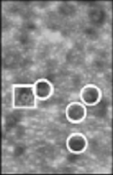
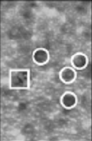
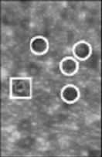
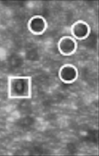
Plasmonic Trapping of Cells
Single Yeast Cell Trapped in Square
(other cells moving at constant speed)
Optical intensity required for stable trapping of single yeast cell is 78.8 μW/μm²
Trapped Cell
Moving Cells
Array of Au Nanostructures
X. Maio and L. Y. Lin, IEEE J. Sel. Topics Quant. Elec. 13 2007

Slide 15
Modeling Optical Nanotrapping
Dielectric Model for Metallic Nanoparticles.
Predict EM Field (Full-Wave Time-Harmonic Analysis)
Compute Time-averaged Optical Force ⟨F_{opt}⟩ on Dielectric Nanoparticles (Dipolar Force)
Identify Regions of Trapping
Use ⟨F_{opt}⟩ to Predict Particle Motion.

Slide 16
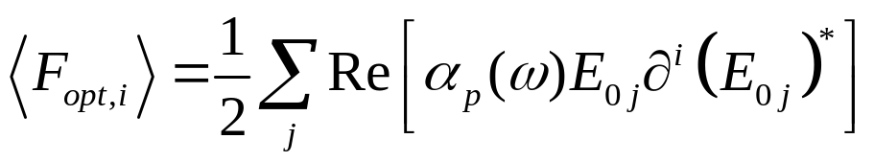
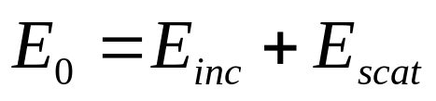
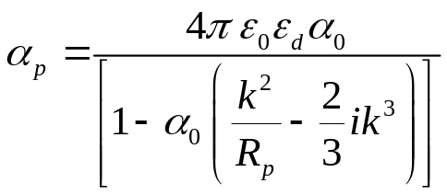

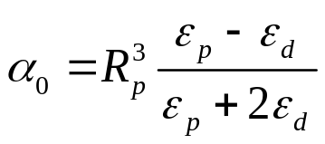
Optical Force on a Dielectric Nanoparticle
Time-averaged Optical Dipolar Force ⟨F_{opt}⟩ is a function of several variables: λ, ε_{p}, ε_{mp} (ω), ε_{d}, and the geometry, composition and coupling of metallic nanostructures.
E_{inc}(t)
ε_{p}
ε_{p}
ε_{d}
+ -
+ -
ε_{mp}(ω)
ε_{mp}(ω)
+ -
+ -

Slide 17
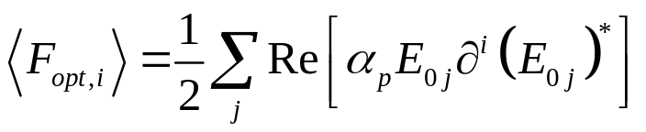



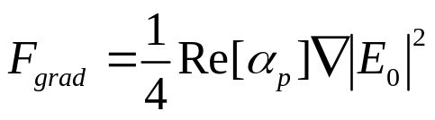
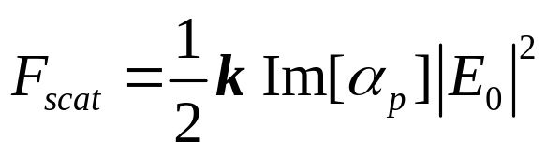

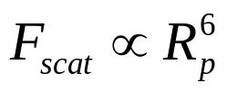
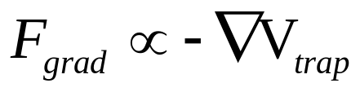
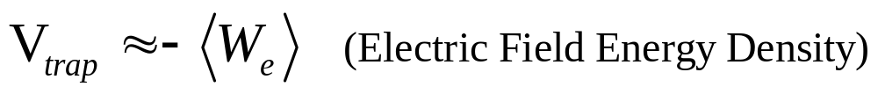
Trapping and Scattering Force Components
Trapping Potential V_{trap}:

Slide 18
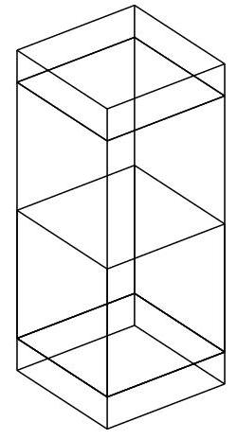



Full-Wave Time-Harmonic Analysis
(Array of Nanopillars: Glass Substrate covered with H2O)
Computational Domain
y
x
k
k
PML
H2O
PEC
ε_{p}
3.4 μm
2 μm
Glass
PMC
PML
2 μm
2 μm
Symmetry Boundary Conditions: PEC, PMC

Slide 19
Computational Model
Surface current J_{x} BC chosen to produce plane wave: Ex = 2×10⁶ V/m.
FEA Model: 43,904 cubic vector elements with 838,485 degrees of freedom.
Computational Domain
CPU Platform
Dual Processor (3 GHz)
Quad Core
Windows XP 64 Bit
32 GB Ram
Time: 15 min per given λ
y
x
k
J_{x}
PML
H2O
Incident Intensity
5.3 mW/μm²
PEC
ε_{p}
3.4 μm
Glass
PMC
PML
2 μm
2 μm
Symmetry Boundary Conditions: PEC, PMC

Slide 20
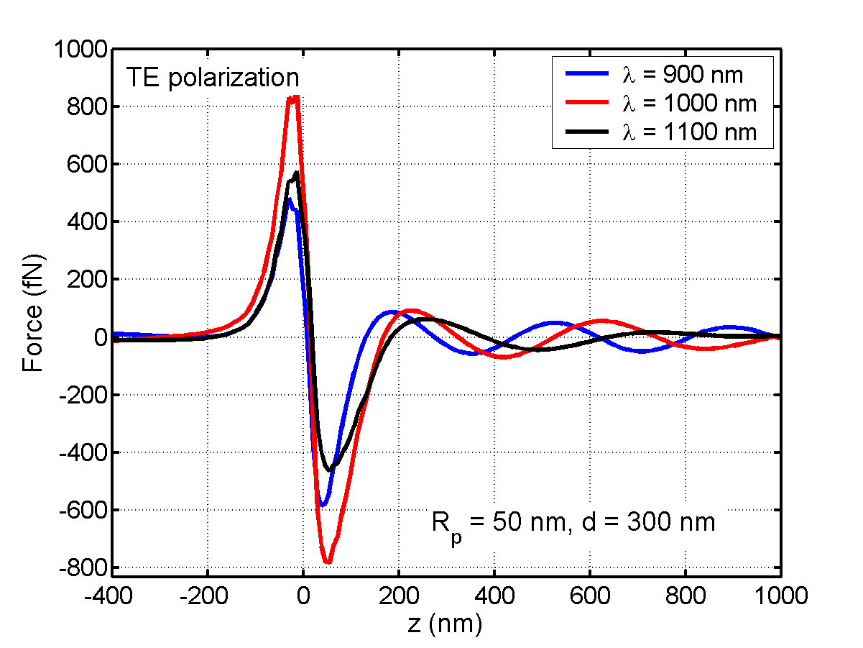
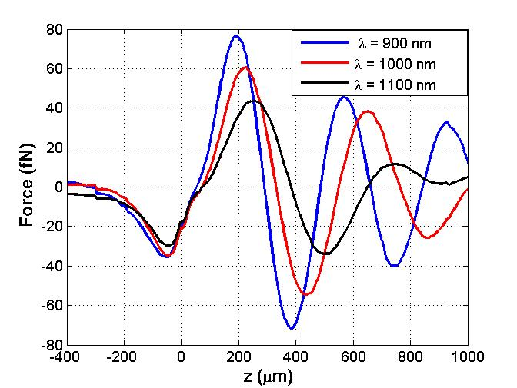
Axial Optical Force vs. Field Polarization
Trap
E_{inc}
TE
k
TM
k
ε_{p}
F_{z} along this line
TM polarization
Trap
H2O
Glass
k

Slide 21
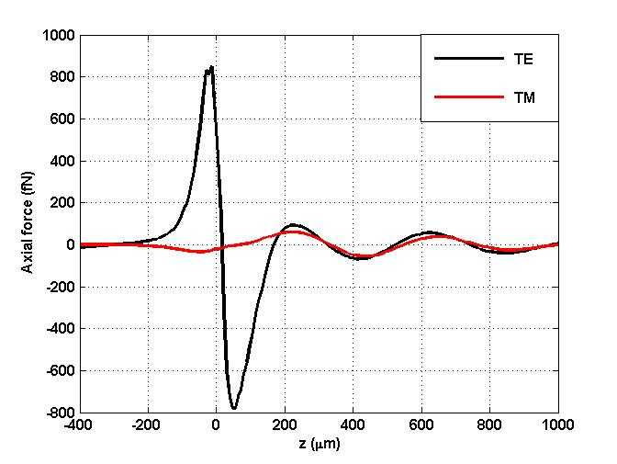
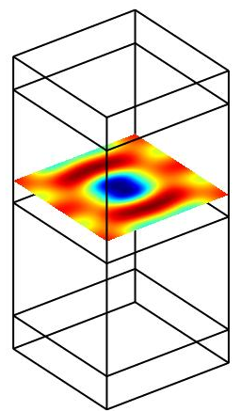
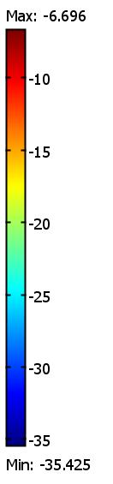
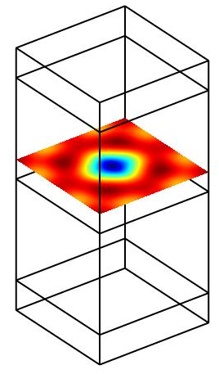
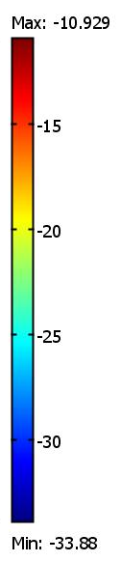
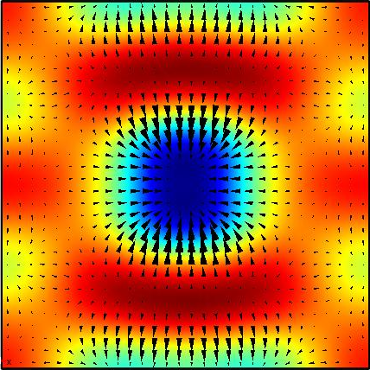
Optical Force Analysis
Rp = 50 nm
λ = 1000 nm
Trap
E_{inc}
TE
TM
k
k
ε_{p}
TE Analysis
-<W_{e}> J/m³
TM Analysis
-<W_{e}> J/m³
TE Analysis
Trapping
Potential
Force Vectors in x-y Plane
H2O
H2O
Glass
Glass

Slide 22
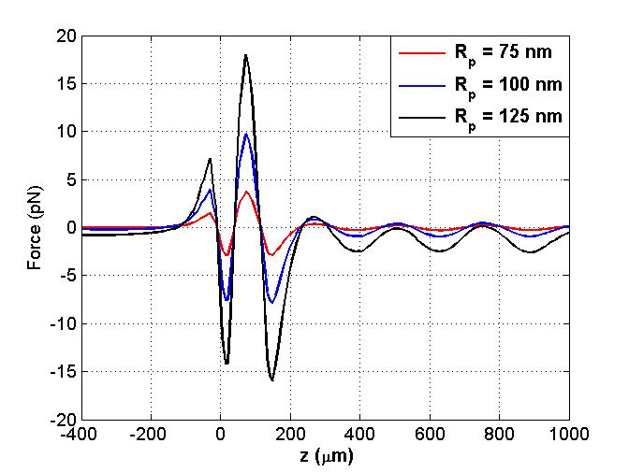
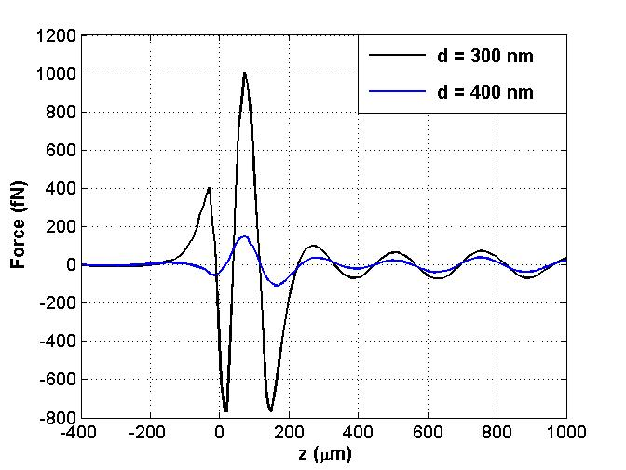
Trapping Force Analysis
E_{inc}
TE
TE Polarization
λ = 635 nm
TM
k
ε_{p}
d
Force vs. Particle Size
Force vs. Cone Separation
Rp = 50 nm
No Trapping for Large Particles
Scattering Force Dominates
k
k

Slide 23
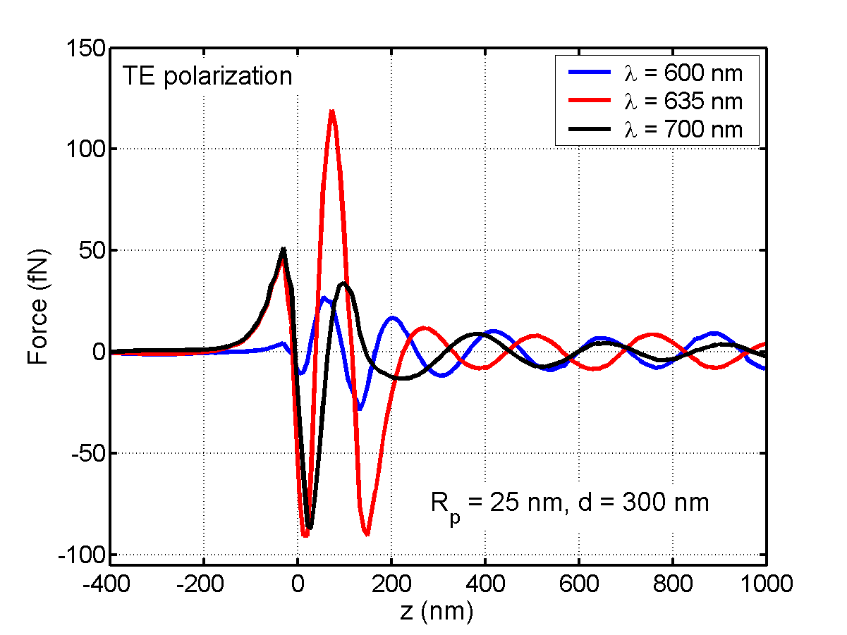
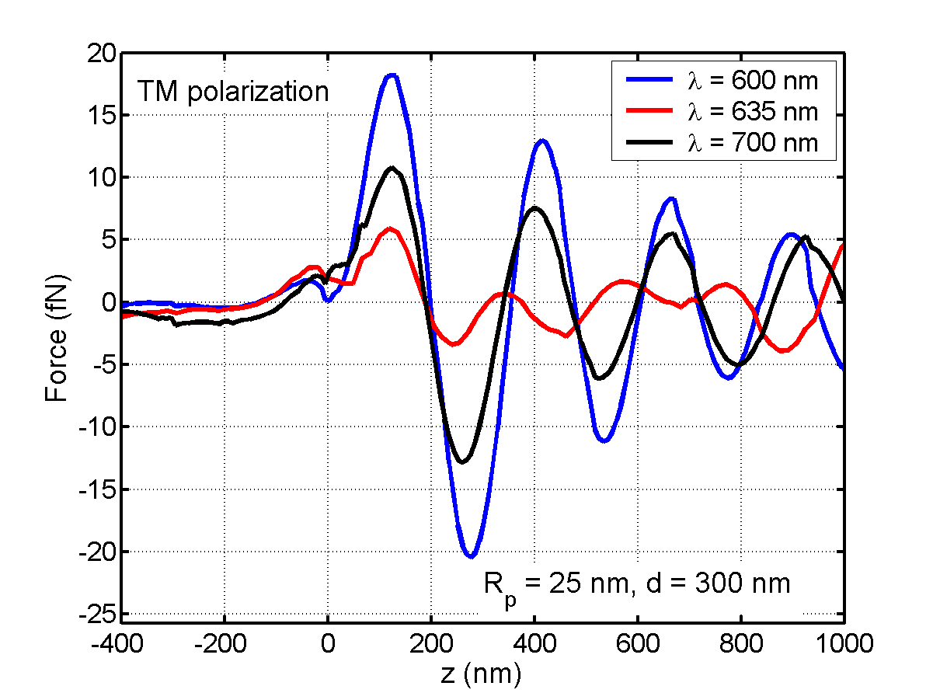
Axial Optical Force vs. Field Polarization
Trap
E_{inc}
TE
k
TM
k
ε_{p}
F_{z} along this line
Trap
H2O
Glass
k

Slide 24
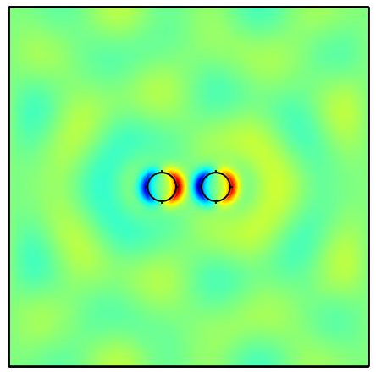
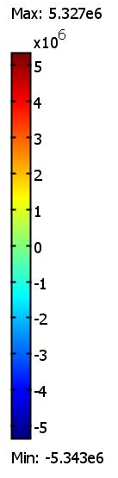



Induced Electromagnetic Modes
Side View
Top View – Induced E_{z}
x
E(t)
Induced E_{z}
Top View
λ = 635 nm
- +
- +
-
-
-
+ + +
-
-
-
+ + +
+ -
+ -
-z
λ = 1000 nm

Slide 25


2D Array of Pillars
TE Trapping vs. λ
R_{p} = 100 nm
Trap
E_{inc}
TE Analysis
TE
Glass/Air
k
TM
k
ε_{p}
F_{z} along this line
R_{p} = 100 nm
Trap
H2O
TE Analysis
Glass/H2O
Glass
k

Slide 26


2D Array of Rings
TE Trapping vs. λ
R_{p} = 100 nm
Trap
E_{inc}
Air Only
TE
k
TM
k
ε_{p}
R_{p} = 100 nm
F_{z} along this line
Trap
300 nm
200 nm
H2O
Glass/H2O
600 nm
Glass
k

Slide 27
Summary and Conclusions
Optical trapping of neutral sub-wavelength particles can be achieved using local field enhancement near illuminated metallic nanostuctures.
Nano-trapping can be achieved with plane wave illumination.
Trapping force depends on particle size, λ, polarization and background permittivity.
Integration in Lab-on-Chip applications: Opto-fluidics

